Slide 1
These slides by Anna Foss and all those listed on the last slide (Acknowledgements) are licensed under a Creative Commons Attribution-NonCommercial 4.0 International License.
You can download via the File tab on the menu bar. Please email anna.foss@lshtm.ac.uk if you use/adapt these slides or to enquire about updated materials.
This project is funded by the University of London Worldwide through an award from the Centre for Distance Education

Slide 2
Background
For further information about this mentorship scheme and the associated research project, please see abstract by Anna Foss et al. from the 13th Research and Innovation in Distance Education, and eLearning (RIDE) annual conference, London, UK, presented on 15 March 2019:
https://london.ac.uk/sites/default/files/leaflets/ride-2019-long-programme.pdf
Email anna.foss@lshtm.ac.uk to find out more

Slide 3
Learning objectives
Understand the roles of mentor and mentee and hear each other’s perspectives
Be prepared to make a video sharing experience on the Project Module
Know how to establish and manage expectations and relationships
Explore the skills and models of effective mentoring conversations

Slide 4
Welcome and introductions
State whether you are a current experienced mentor or a new mentor to be (in terms of the Project Module)
Mention any other relevant experience aside from the Project Module of mentoring or being mentored

Slide 5
Formats of support from mentors
Group mentorship model with a group of mentors supporting all students (with a 2 year gap between cohorts), from a distance
Components to streamlined sustainable mentorship scheme:
Moodle discussion forum interactions with students, Alumni Mentors, PMOs and Library staff
Collaborate Ultra sessions with students, Alumni Mentors, PMOs and Library staff at key project stages
Added extra if time/resources permit:
Videos responding to Project Module Organiser (PMO) questions about your experience on the Project Module
Notes:
It’s a group mentoring approach so not one-to-one.
Mentors operate as a group supporting all students and only interact within the bounds of Moodle/Collaborate so that all students benefit and PMOs are around monitoring/inputting as required.
I ask mentors to share with me the drafts of their initial introduction message and first reply to a student prior to posting on Moodle.
Following this, there is generally no need for mentors to check Moodle posts with PMOs first (unless you are unsure about anything), but we as PMOs will post any messages of clarification afterwards, if needed.

Slide 6
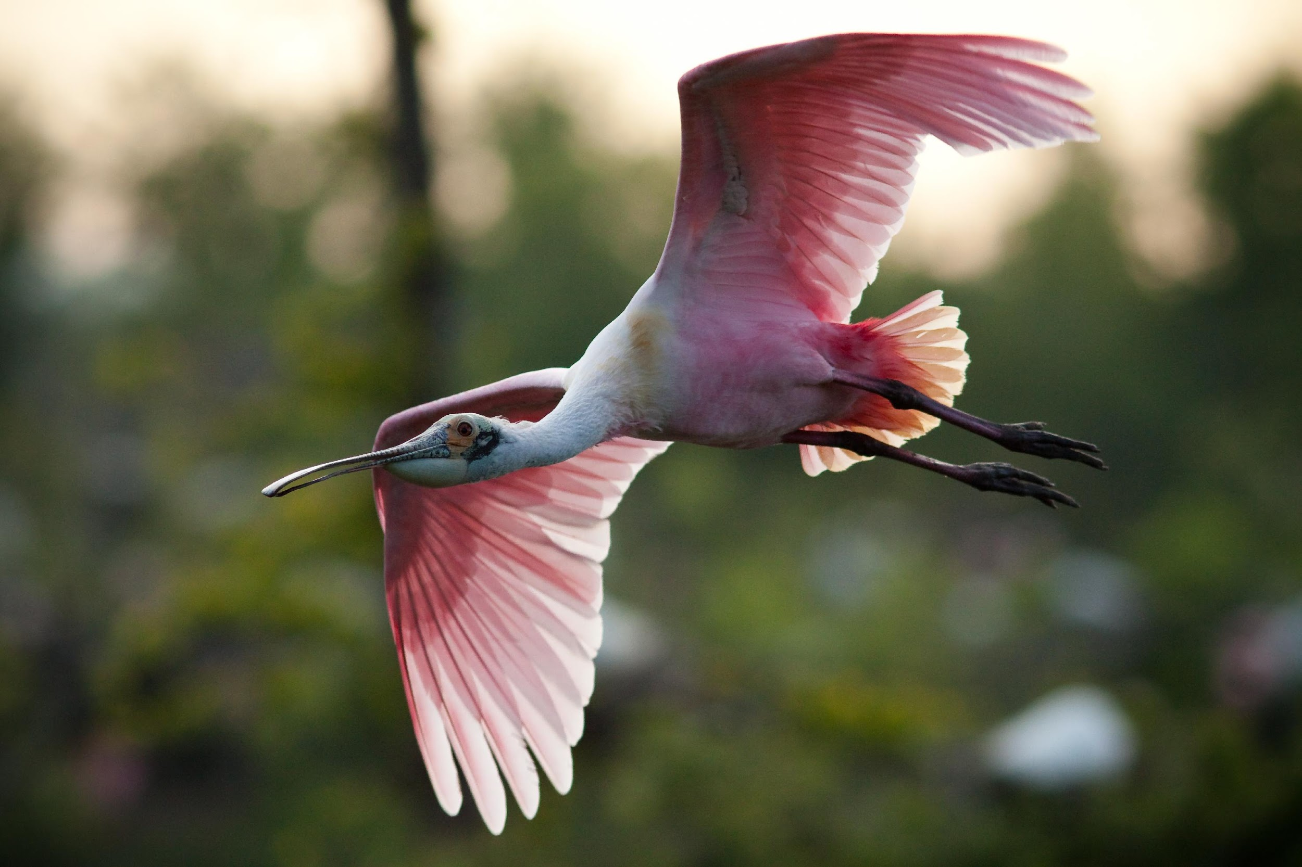
Some words/phrases we might associate with the role of mentor
What words/phrases do you associate with the role of mentor?

Slide 7
Some words/phrases we might associate with the role of mentor
Listening
Sharing experience
Facilitating
Encouraging
Supporting
Challenging (gently)
Inspiring

Slide 8
Role of mentors
Companions to ‘walk’ empathetically with mentees through the ups and downs of their MSc project work
Offer your own experiences by talking/writing as “I did this and then found that I needed to….” or “I found this helped me…” rather than giving advice to mentees (e.g. not “I think you should…”)
Note that it is the role of staff (supervisors and PMOs) to guide and advise students, not the role of mentors
Share what you would have done differently with the benefit of hindsight
Ask mentees questions to support their Masters-level independent critical thinking, e.g. “Have you considered….?” or “What will you do if….?”
If you do make the occasional suggestion then refer students to check these with their supervisors or PMO
Sign off written communications as “Alumni mentor” so that students are aware of your role (and make role similarly clear in verbal communications)
Contribute your own ideas to the development of this scheme, including this package of mentor training for future mentors

Slide 9
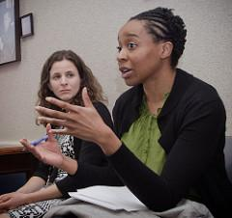
Developmental model of mentoring
Mentors encourages autonomy and self development, identifying not providing opportunities for development
Recognition of value for both mentors and mentees - mutuality of learning
Encourages mentees to do things themselves
No line of accountability
It’s about experience not hierarchy
Each mentee in driving seat
Notes:
Developmental Mentoring emerged in Europe in the 1980s as a process for empowering others to take charge of their own development. Here, the Mentor’s accumulated experience and wisdom are not necessarily passed on, but can be accessed when appropriate.
Features of Developmental Mentoring:
The Mentee needs to achieve some form of change – e.g. in their level of understanding or taking on more responsibility.
There is a high level of trust and openness that allows the Mentor and Mentee to address difficult issues as they arise.
There is no line of accountability, i.e. boss and direct report, or parent and child. Usually the Mentor has little direct ‘power’ over the Mentee.
Generosity of time and help by the Mentor.
Recognition of the value in learning together despite the different levels of experience.

Slide 10
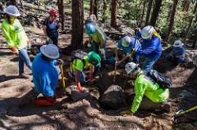
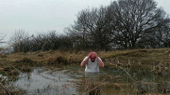
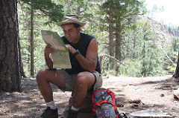
Project journey
Plan seemed straightforward….
….but reality was very different!
Notes:
Developmental mentoring approach can help people navigate this journey.
Supporting people to overcome these obstacles and distractions is a key part of your role, but building personal capacity in them to grow their own ability to overcome this is crucial for now and future resilience.
The aim here is to foster independence not interdependence.

Slide 11
Effective Mentor | Effective Mentee
Establishes rapport | Establishes rapport
Maintains confidentiality | Maintains confidentiality
Displays empathy | Prepares for engaging with mentors
Listens | Shares issues/challenges
Give mentee space to talk | Open to different perspectives
Encourages reflection | Prepared to think deeply around issues/challenges
Attention | Ready to take action
Trusted
Willing to share experiences

Slide 12
OSCAR Model
Outcome – establish what mentee wants to achieve in the session
Situation – evaluate the current situation
Choices & consequences – different options to explore
Action – what’s the mentees preferred strategy
Review – mentee to decide how progress will be reviewed
Notes:
Outcome
• What do you want to achieve? • How will you know that you have achieved it? • Describe what success looks like?
Situation
What does the current situation look like? • What factors are contributing to the current situation? • What are you doing that might be contributing to the situation?
Choices and Consequences
What could you do to sort out the issue? • What might be the consequences of doing that? • What would you do if you knew there would be no repercussions?
Action
What will you do next? And when? • How motivated are you to do this on a scale of 1 to 10 • (If it’s not 9 or 10) Why isn’t it a 9 or a 10?
Review
How will you monitor your progress? • How will you measure the outcomes? • How will you know you are moving towards the results you want?

Slide 13
Let’s hear from experienced mentors
What is it like being a mentor?
What is the expected time commitment?
(New mentors please ask additional questions of experienced mentors…)

Slide 14
Frequently asked questions
What is the expected time commitment? Do we have to commit up until Sept 2020?
Experienced mentors can answer this better! I’d say it’s very variable and driven by what you can afford to offer as well as how many student queries there are. I’ll do a Doodle poll ahead of Collaborate sessions to try to work around mentor availability as much as possible. With the group model other mentors might be free when you are busy (just keep in touch to let us know). It’s fine to start as a mentor even if you can’t yet fully commit from May 2019 until Sept 2020.
What is we are part of a Facebook or WhatsApp group of distance learning students, can we respond to students there?
Please refer any Project Module students on Facebook/WhatsApp to Moodle if you wish to respond in your formal role as an Alumni Mentor.
3. Can we directly contact other new mentors and experienced mentors?
Yes you can email/Skype each other (but not students).
Notes:
Experienced mentors can answer this better! I’d say it’s very variable and driven by what you can afford to offer as well as how many student queries there are. I think it will be busiest around July-Sept 2019, then Feb-March 2020, then July-Sept 2020. Many weeks are free/empty! I’ll do a Doodle poll ahead of Collaborate sessions to try to work around mentor availability as much as possible. Time commitment is flexible with our group model and so hopefully manageable even if additional work/family commitments come along as other mentors might be free when you are busy (just keep in touch to let us know). It’s fine to start as a mentor even if you can’t yet fully commit from May 2019 until Sept 2020.
I’ve had a good level of interest so far so I feel like there are a sufficient number of mentors that we could manage if 1 or 2 dropped out later on (as long as different project types/methods). However, I say this only in the hope that it doesn’t put people off at this stage if they can’t yet fully commit from May 2019 until Sept 2020….of course I’ll be rather stuck if a lot drop out so really hope that doesn’t happen!!

Slide 15
Helpful questions (for mentors to use)
Open – What is the issue? Why do you think that is?
Probing – What actually happened? What could be the barrier / cause of the problem?
Reflective – What has/hasn’t worked so far? What do you not know? How could you find out what you need to? What resources will you need?
Clarifying – Do you mean you would prefer to…?
Comparative – Which was most successful for you (this or that)?
Hypothetical – What if…? What barriers or challenges can you anticipate? What’s the worst that can happen?
Notes:
Helpful questions
Open – opens up dialogue and gives mentee space to think and provide full answer. Use Why sparingly as can feel like interrogation.
Probing – fill in details and help mentee explore issues in-depth
Reflective – repeat what mentee has says, helps mentee see impact and may lead to further insight.
Clarifying – helps mentor understand issue
Comparative – helps mentee reflect. Give option of following with how/what.

Slide 16
Unhelpful questions (for mentors to avoid!)
Leading – Wouldn’t you say that was a good idea?
Multiple – What was your last project, why did you change it and what didn’t you like about it?
Catch/Trick – What were you trying to do…..is that really what you needed to do for your MSc project preparation?
Closed – Do you enjoy your job?
Notes:
Unhelpful questions
Leading - Where questioner knows the answer they expect and leads the mentee to give that answer.
Multiple – sting of questions in one. Mentee usually answers the last one or one they like the best?
Trick – attempt to trick the mentee into revealing something through answering an apparently different question.

Slide 17
Video activity
Click the following links to watch these 2 videos about one-to-one mentoring (keeping in mind the question below):
Then:
Raise your hand in Collaborate once finished
Type your response to the question below in the chat window in Collaborate:
Although the videos are about one-to-one mentoring, what aspects do you think apply also to our group mentoring model?
https://youtu.be/OuW36Q60XyI?list=PLGcyo9J-J_ETP9e2yKGOnhC-nEAFuiU29
https://www.youtube.com/watch?v=z_-rNd7h6z8

Slide 18
My thoughts on what is relevant in the videos for our group mentoring model
1st video
Offer a different, more objective, perspective
Encourage students to critically reflect and develop problem solving skills
Ask questions rather than tell students what to do, e.g. “What made you think that? How did you come to that conclusion?”
Empower students to find their own way forward
Offer supportive challenge
2nd video
Invest time and focus in trying to understand what student is communicating rather than being overly distracted by what you will say in response
Don’t respond too quickly – allow time for reflecting on what you’ve heard/read
Respond in a non-judgemental way
Summarise/paraphrase what they said, including emotions
Notes:
Encouraging students to critically reflect on what they are doing, think out loud, and develop problem solving skills, goal setting, mentors ask questions rather than tell students what to do, empower students to find their own way forward, offer supportive challenge to stretch and show you have confidence in them to achieve. Asking questions like: “What made you think that? How did you come to that conclusion?” Offer a different, more objective, perspective.
Invest time and focus in listening/reading what student is trying to communicate and trying to understand this rather than being overly distracted by what you will say in response.
Don’t respond too quickly – allow time for reflecting on what you’ve heard/read.
Respond in a non-judgemental way.
Summarise/paraphrase what they said, including emotions.

Slide 19
Managing expectations
New/prospective Project Module students will be made aware that:
Mentors are giving up their time voluntarily to provide this additional support as and when they have time available (in group format, not one-to-one)
Mentors will be sharing their experiences but not giving advice (since it is the role of supervisors and PMOs to guide students, not the role of mentors), so caution should be exercised when interpreting contributions from mentors in the same way as interpreting peer support from other students
PMOs will also clarify/correct anything deemed misleading from a mentor in the same way as if other students wrote/said something wrong or inappropriate

Slide 20
Ground rules and boundaries to build trust in relationships
Demonstrate respect for confidentiality, within the boundaries of Moodle/Collaborate, unless you believe there is a serious or potentially serious danger to a student or others, in which case you need to immediately phone *** as well as emailing *** as soon as possible
As difficult as it can be to work around everyone’s availability, we need to try to maintain as much consistency among the group of mentors as possible in order to build trust and a sense of safety among those mentees who commit to regularly joining Collaborate sessions and/or posting on Moodle
Provide reassurance that all questions are welcome and valued (and valuable to others), so there’s no such thing as a ‘silly question’ or concern etc. – meaning mentees feel safe to share these
For transparency and so that all students can benefit, interactions between mentors and mentees should be only within the boundaries/mechanisms of support as agreed here (e.g. do not meet face-to-face with students nor connect with students via social media, email, Skype/Facetime/phone or by any other means)
Acknowledgements to MENTOR: The National Mentoring Partnership (https://www.youtube.com/watch?v=TXSVO29x7Pc&t=46s)
Notes:
Slide based on some useful bits from about 13 mins into this video up to about 30 mins (and see more resources on end slides):
https://www.youtube.com/watch?v=TXSVO29x7Pc&t=46s

Slide 21
Managing relationships/connections
Mentees will hopefully have viewed your fantastic alumni-mentor videos prior to the Collaborate session and so it is helpful if you:
Use the video facility in Collaborate so that mentees recognise you
Include your photo in your Moodle profile for your discussion forum posts
Make any natural reference to your involvement in these videos
Introduce yourself and your project briefly the first time you post a message on Moodle or speak/chat on Collaborate
Share your experiences in a rich and authentic way but without going into too much specific detail – stay focused on what is relevant to mentee
Show that you have remembered mentees when reconnecting with them in different Collaborate sessions and/or different platforms (e.g. Moodle discussions form and Collaborate Ultra)
Acknowledgements to MENTOR: The National Mentoring Partnership (https://www.youtube.com/watch?v=TXSVO29x7Pc&t=46s)
Notes:
Slide based on some useful bits from about 13 mins into this video up to about 30 mins (and see more resources on end slides):
https://www.youtube.com/watch?v=TXSVO29x7Pc&t=46s

Slide 22
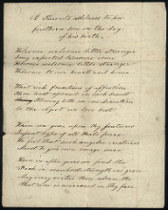
Voice/style of writing
Conversational not lecture or teaching
For many English is an additional language so use simple conversational English (avoid slang, idiom and jokes)
Speak/write from personal experience

Slide 23
Supporting each other
If possible / over time, build relationships with other alumni mentors and show you are working as a team, e.g. appropriately referring questions to each other based on what you know about each other’s projects, disciplines, backgrounds, experience
We as PMOs and mentors are also a team of support for the new students
Ultimately, PMOs will facilitate Collaborate sessions so this doesn’t all rest on you!
Experienced mentors are also available on Collaborate today as an additional source of support for you.
Acknowledgements to MENTOR: The National Mentoring Partnership (https://www.youtube.com/watch?v=TXSVO29x7Pc&t=46s)
Notes:
Slide based on some useful bits from about 13 mins into this video up to about 30 mins (and see more resources on end slides):
https://www.youtube.com/watch?v=TXSVO29x7Pc&t=46s

Slide 24
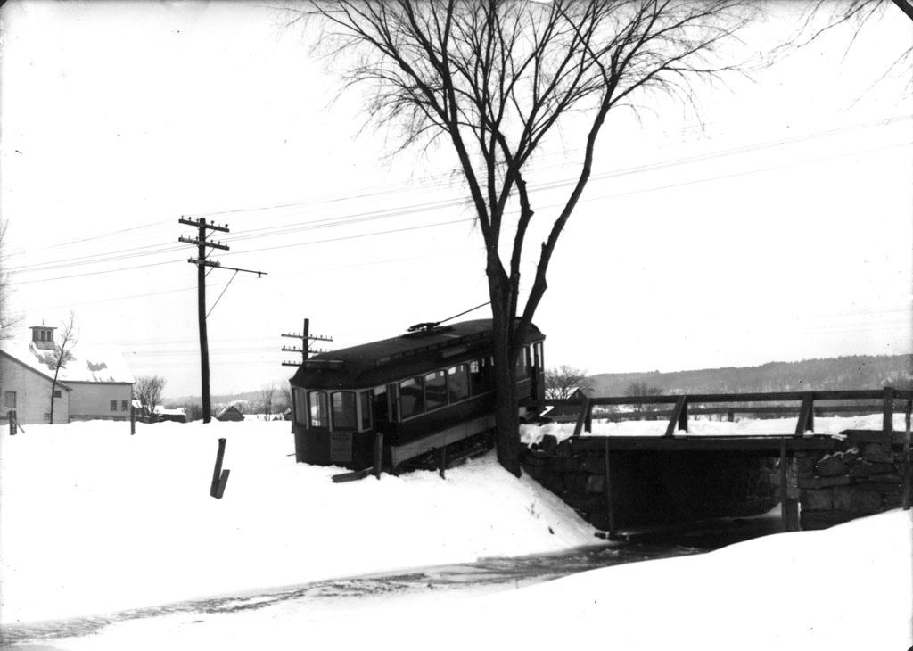
What can go wrong?
Observations to date:
Use of incorrect terminology to describe PMOs, Supervisors, Examiners or Alumni Mentors
Referring to incorrect deadlines/timings or procedures
Overstating belief student will do well
Giving advice
Misunderstanding student’s query
Possibilities:
Boundaries
Lack of engagement
Over-dependent mentee
Inappropriate breach of confidentiality
Conflict of interest
Incompatibility
…although risk of some of these mitigated somewhat by the group mentorship model
Notes:
I suggest you say more like “I believe you can do it” rather than “you will definitely do it” or “I’m sure you will pass”, so that you are encouraging and show belief in them without overstating this (given that they are at the start of their journey and you will not be the examiner!)
Terminology: Me and Sarah Smith (who took over from Rebecca French) are “Project Module Organisers (PMOs)”, your “supervisor” gave you specific feedback on forms and regular Skypes, your “examiners” gave you grade and final feedback, and you are “alumni mentors”

Slide 25
Code of Conduct
You will be asked via email to read and ‘sign’ the Code of Conduct for Alumni Mentors on the Project Module.
The Code of Conduct describes expectations, the extent and boundaries of your role as an Alumni Mentor, and permitted communications within this role.
If you are happy to 'sign' this then please email me back (via ****) to say:
“I confirm that I have read and understood the attached Code of Conduct and agree to follow this in my role as an Alumni Mentor for the Project Module.”
Let me know if you do not wish to share your email address (with relevant LSHTM staff and other Alumni Mentors) or have any other concerns or queries.

Slide 26
Overview of Moodle activities and timeline
Date and student status | Moodle Discussion Forum activity
May 2019 (Prospective students pre-proposal stage) | Use new Moodle login details to Create profile Post introduction message on the Prospective Students Forum
May to September 2019 (Prospective students pre-proposal stage) | Respond to student posts on the Prospective Students Forum and encourage interactions Participate in a Collaborate session
October 2019 to September 2020 (Students registered onto Project Module) | Respond to student posts on the main Project Module Discussion Forum and encourage interactions Monitor library discussion forums in Feb-March 2020 for a specific group of students (one mentor per group of approx. 10 students) to ensure all get a response from a peer or, if not, post a reply as a mentor Participate in several Collaborate sessions at key stages

Slide 27
Questions
The questions on the next slide are suggestions to prompt you about what we are trying to capture here in your introductory message on Moodle (and/or videos)
Please feel free to answer as many or as few questions are you feel are relevant to you, and add in your own questions to yourself too if you like

Slide 28
Questions from PMOs to mentors
How does it feel to have completed the Project Module and now be graduating from your MSc?
What has your ‘journey’ felt like through the Project Module from initial ideas to completion?
What was the most valuable skill you developed or insight you learned or exciting moment from your MSc project experience?
What resources have you found most helpful?
What is/are the most important thing(s) you wish you had known or done prior to starting your MSc project? What would you do the same and what would you do differently, if you were repeating the Project Module again, now with the benefit of hindsight?
What challenges did you face and how did you overcome these?
Has your MSc project been useful in your local setting? Has it had any impact on your professional career, any local public health or personal benefits in your setting, any follow-on work?
Notes:
Filming from the graduation in March 2018 was edited together with remote recordings in order to produce a series of seven videos which combined responses from eight alumni mentors to the following questions from PMOs

Slide 29
Draft schedule of Collaborate Ultra sessions
Date | Collaborate session number and stage
Early/mid July 2019 | Collaborate session 1 (Prospective project student pre-proposal stage)
Early/mid October 2019 | Collaborate session 2 (Newly registered student Proposal stage)
Early/mid January 2020 | Collaborate session 3 (Student Ethics application stage)
Feb/March 2020 | Collaborate session 4 (Student Library information skills training)
Early April 2020 | Collaborate session 5 (Student Methods development stage)
Mid/late July 2020 | Collaborate session 6 (Student Draft Report stage – preliminary results)
Early/mid September 2020 | Collaborate session 7 (Student Draft Report stage – write-up)
Notes:
Library will run several Collaborate drop-in clinics in Feb and March, if you can join any, but key one to join will be the end ‘wrap-up’ session in mid March.

Slide 30
Draft schedule for first Collaborate session
Early/mid July 2019
Time | Activity | Lead
10 mins | Welcome and introduction to Project Module and mentorship scheme | PMOs
10 mins | Ice-breaker | PMOs
30 mins | Mentees ask questions for mentors to respond to through sharing their experience (via microphone or chat) - mentors to briefly introduce themselves and their project prior to responding to a question Mentors to be prepared with questions to facilitate this Q&A session, if needed. PMOs to provide any clarification or additional points only after mentors have responded. | Mentors (with PMOs)
10 mins | Wrap-up summary of what we’ve all learnt from this experience, via everyone typing in chat window and PMOs on microphones | PMOs

Slide 31
Preparing for Collaborate Ultra or Moodle posts
Audience: How might they be feeling at this stage in the project cycle (how were you feeling at this stage)?
Your experience as a successful student (you passed!) is a precious resource
Empathise with and normalise feelings of new students
Encourage their self-reflection and clarity of communication, e.g. through helpful questions (see earlier slide)
Listen well
Manage their expectations
Be clear and specific, using concrete examples from your own project / location
Be positive and supportive
Be honest and kind about any concerns, referring on to supervisor/PMO
Build their confidence and independence
Demonstrate enthusiasm for the Project Module
Talk/write about your outcomes and success
Inspire these new students!
Share with the PMO the drafts of your initial introduction message and your first reply to a student (by emailing anna.foss@lshtm.ac.uk) prior to posting on Moodle

Slide 32
Collaborate Ultra Considerations
Decide ahead of each Collaborate Ultra session whether or not you will use all or just some of the following (noting that all are useful to build rapport but be aware that the sessions will be recorded)
Video
Microphone
Speakers
Chat
Make it clear which student you are responding to and that your own role is as an alumni peer mentor
Note that there may be different conversations occurring simultaneously using microphones and via the chat window!
Be yourselves and smile – treat it as a relaxed normal conversation and try to not let nerves get in the way!

Slide 33
Technical details for Collaborate Ultra
Please refer to your copy of ‘Collaborate Ultra Student Guide’
Note that we will be using Collaborate Ultra, which is an updated version of what you may have used on the Project Module
Add “(mentor)” after your name when joining Collaborate or make it clear in your responses that you are a mentor
Ensure that you log in to Collaborate Ultra 15 minutes early to test your video and audio, and familiarise yourself with the new layout and icons
Use the ‘raise hand’ function to indicate when you are trying to speak and PMO will signal order of speakers

Slide 34
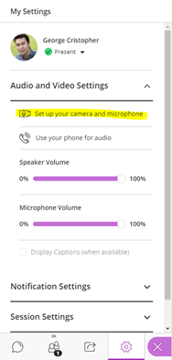
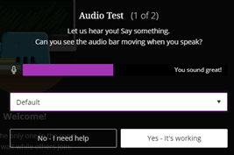
Collaborate pre-launch checks and settings
Browser
Chrome or
Firefox (versions 49+)
Operating System
Windows 7+
Mac OS 10.9+
Mobile
IOS 8+, Android 4.0.3+, or Windows 8.1+
Camera & Microphone
3
1
4
2
Raise hand
Turns microphone on/off
Turns video on/off

Slide 35
Technical details for Moodle
Please refer to your copy of the ‘Student Guide to PH (DL) on-line communication via Moodle’
Please ensure that you hide your email address from students in your Moodle profile and feel free to add a photo and short written bio to introduce yourself yourself there as an “Alumni mentor”, outlining your background, experience on the Project Module and what you are doing now (or whatever you’ve like to share about all this)
Note the following disclaimer (applying also to Collaborate sessions):
The discussion forums are solely for educational purposes and to facilitate communication between students, staff and alumni mentors. The views and opinions posted to a forum do not necessarily reflect those of the School. We welcome constructive dialogue and debate; however, please consider the School’s key values regarding respect for our diverse community when posting. The School reserves the right to monitor the forum and any message deemed to be offensive will be withdrawn without notice, and could result in disciplinary or legal action against the offender. Please contact us immediately if you have any concerns or think a post may go against the key values of the School.

Slide 36
Inspirational videos on mentoring
https://www.youtube.com/watch?v=wtr--uo_WMc
https://www.youtube.com/watch?v=Atme26C0l5E

Slide 37
Acknowledgements
All authors/investigators:-
Principal Investigator:
Anna Foss, Associate Professor, Project Module Organiser (PMO) and a Director of LEARN – the Learning and Educational Advances Research Network, London School of Hygiene and Tropical Medicine (LSHTM): anna.foss@lshtm.ac.uk.
Co-Investigators:
Associate Professor and a former PMO, LSHTM: Rebecca French
Assistant Professors in Learning & Teaching, LSHTM: Jenny Fogarty and Mike Hill
Associate Professor and Programme Director, LSHTM: Ros Plowman
Student partner mentors, LSHTM: Grace Mambula, Sumedh, Samuel Van Steirteghem, Olivia Perrotta Hare, Sumedh, Vasha Bachan and Mary-Ann Schreiner
Student partner mentees, LSHTM: Sophia Kohler, Natalina Sutton, Tolu Osigbesan, Nadia Tekkal and Nicolò Saverio Centemero
Centre for Distance Education (CDE) Fellow: Alan Tait.
All mentors and mentees
Funder:- This project is funded by the University of London Worldwide through an award from the Centre for Distance Education.
Thanks also to:-
Margaret Bentley and the Talent and Educational Development team at LSHTM
Sarah Sherman, Bloomsbury Learning Environment Service Manager
MENTOR: The National Mentoring Partnership (https://www.youtube.com/watch?v=TXSVO29x7Pc&t=46s)

Slide 38
THE SLIDES THAT FOLLOW ARE ONLY FOR USE IF THE INTENTION IS TO PRODUCE A SERIES OF VIDEOS FROM ALUMNI CONTRIBUTIONS

Slide 39
Considerations for panel discussion videos
Show a physical artefact if helpful, e.g.
filmed in the working space you used for MSc project
a tablet computer or smartphone
print-outs of figures/tables from your project
a symbol of your project topic or setting
Keep it succinct (1 minute per person per question)!
See earlier slides on Questions from PMOs to mentors

Slide 40
General advice from the Video Studio team: filming around graduation
Preparation is key – write and rehearse the delivery of your content beforehand
Please wear your graduation robes, if possible
Avoid wearing patterned clothing (e.g. leopard print, stripes)
Wear clothing onto which a lapel microphone can be clipped and do not wear any clothing that will make noise during filming (e.g. metal jewellery)
Avoid wearing any clothing that could interfere with the microphone (e.g. scarves)
No food or drink in the Studio - but please feel free to bring bottled water
Make sure you arrive on time - Studio time is limited
Be yourselves and smile – treat it as a relaxed normal conversation and try to not let nerves get in the way!

Slide 41
Remotely recorded videos and editing
Videos can be recorded remotely via Panopto – details will be emailed to you
Videos sent in remotely from different mentors will be edited together, along with filming done of alumni in graduation gowns, to develop a series of videos where each video captures responses to a single (or two/three related) question(s)
Note that it is likely that not everything in the original videos will be included in the final videos released to students

