Slide 1
Teaching students about plagiarism: A Case Study
Dr Germaine Symons
Learning Support Team
Dept. of Psychology
Birkbeck, University of London

Slide 2
Outline
Background
Requirements
Current Resources
Some questions…

Slide 3
Background
Who I am:
Learning Development Tutor
Embedded in psychology dept at Birkbeck
Work with very diverse student body

Slide 4
In the beginning… (2014 - 2016)
Problem
Solution
College expected plagiarism to be policed
College resources external to BBK
Non-subject specific
Turnitin became available
Minimal teaching on plagiarism in Dept
‘Compulsory’ short essay on plagiarism
Provided essay plan
Rubric marking (generic feedback)
Feedback minimal
Little time to follow up on non-submitting, or plagiarising ☺ students, or students who didn’t understand the brief.
Needed to embed in the curriculum

Slide 5
Requirements

Slide 6
Need to cover…
Main points regarding plagiarism
Discipline specific as generalized resources can lead students down incorrect paths (e.g. quoting in psychology)
With focus on key issues for students
Context specific examples
Covers citing and referencing (also context specific)

Slide 7
Currently… (2022)
Implementation
Tutorial on Moodle
Understanding Plagiarism
Citing and referencing APA Style
Based on Willmott & Harrison (2003) and tutorial created by Emma Illingsworth, subject librarian at BBK.
Can be done independently, or in seminar environment
Combination of reference information, and activities
Embedded on our Moodle page, with
Links from course Moodle pages or any other locations
All have a tile with the same branding

Slide 8
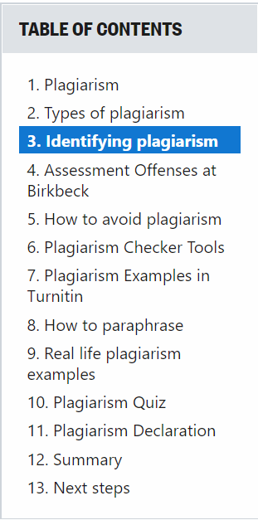
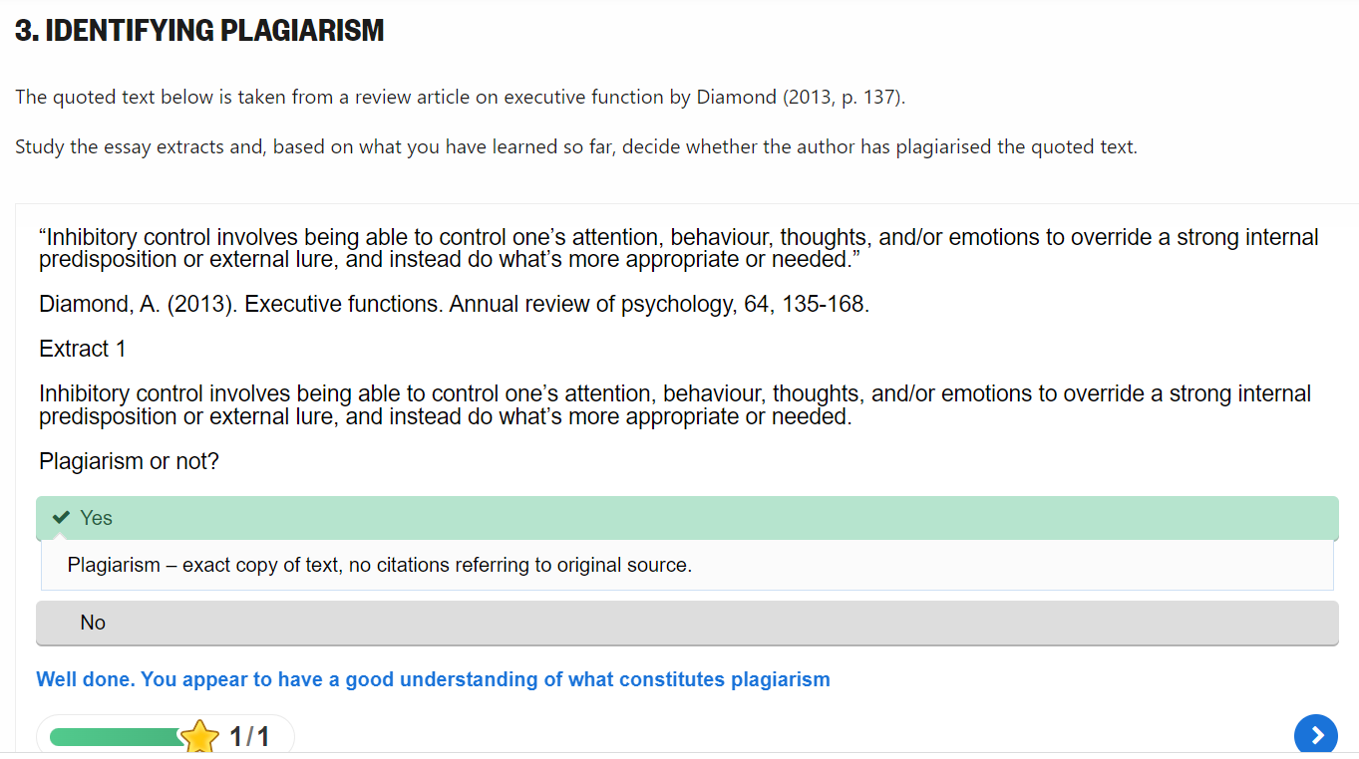
Currently… (2022)
Content
subtitle

Slide 9
Currently… (2022)
Delivery
Problems
UG students - 1st Year Level 4 students in first term in seminar
PG students - directed towards resource and told compulsory
Difficult to get (PG) course convenors to ‘encourage’ students to do
No one follows up on people who do not complete the tutorial
Can induce anxiety in students
Even if students understand concepts, does not mean they understand how to avoid plagiarism in real life

Slide 10
What happens afterwards…
Current
Markers assesses all submissions
If plagiarised, staff fills in assessment offence report
Admin informs student of penalty, and requirement to see LSO (us)
We see student, try to establish what happened, and discuss strategies for avoiding plagiarising in future.
Future
Plagiarism panel (to improve consistency)

Slide 11
Going forward… (2022 onwards)
Using Turnitin as a pedagogical tool
Create online workshop (with help of Sali and Riccado) to broaden understanding of plagiarism by…
Introducing student to the similarity report
Allowing student to practice ‘paraphrasing’ and engage with Turnitin
Student can assess whether theoretical understanding can be operationalized
Allows student to properly interpret similarity report if allowed to submit draft to Turnitin before submission
Allay anxiety
Improve understanding of paraphrasing

Slide 12
Some questions…
Plagiarism avoidance: Continued access to Turnitin similarity reports – impact on learning?
Increase in student anxiety across the sector – impact on plagiarism?

Slide 13
Some questions…
Impact on plagiarism when students arrive at Uni with less developed ‘study skills’ or less knowledge of hidden curriculum
e.g UCAS students educated through pandemic
Students from more disadvantaged background

Slide 14
Thank You
Dr Germaine Symons
g.symons@bbk.ac.uk
lso.psychology@bbk.ac.uk

