Slide 1
Accessible maths online
Christine Cé and Natalie Friend-duPreez

Slide 2
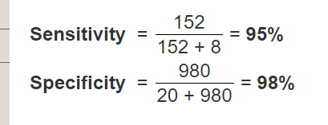
The problem
Equations in CAL: two historical approaches
Images: need alt text – time, resources, training e.g. MathSpeak rules
Tables: not accessible at all
Workflow
CT example
Epi example

Slide 3
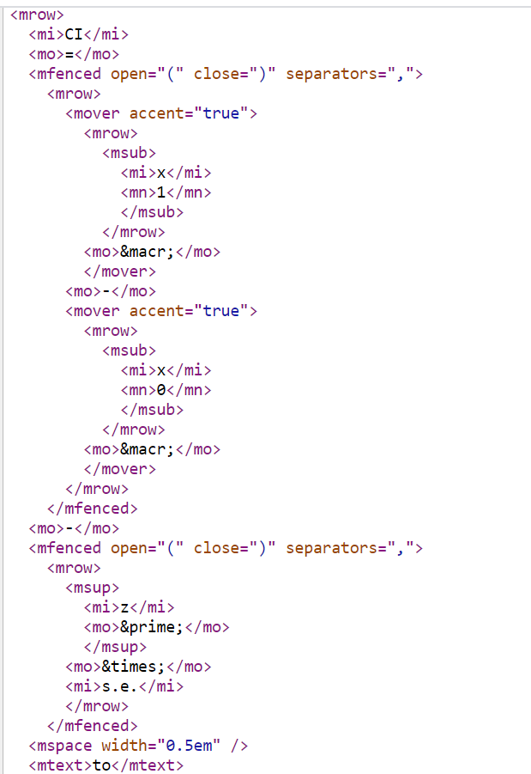
Accessible maths online: MathML
Pros:
Designed for presenting maths online
Accessible to screen reading software
Future-proof
Cons:
Complicated code
No universal native browser support
Notes:
Code fragment is for confidence interval

Slide 4
Maths for all browsers: MathML + MathJax
MathJax:
JavaScript display engine for maths
Works in all browsers
Adds functionality to MathML (e.g. zoom)
ID example

Slide 5
How to generate MathML?
Need: an editor that
Academic team can use to write equations
LTs can use to generate MathML
Is free or very cheap!
Wiris MathType:
WYSIWYG editor: no need to learn LaTEX
Generates MathML and alt text
Multi-platform (Office, Google, VLEs)
Chemical notation editor

Slide 6
Making exam formulae sheets accessible
Complex equations, including any with Greek symbols or a 'times' symbol
Equations that are written out as words can also be converted using MathML and then the style set to “text”. This means that screen readers will read the words as words rather than spell them out to the user.
Equations written in Word document using the MathType add-on
Used simple table format, including using captions and setting header columns and rows so easy for a screen reader to navigate the tables
NonVisual Desktop Access (NVDA) screen reader used to test the equations
MathPlayer™ 4 works with NVDA to speak and Braille math content in Microsoft Word and PowerPoint (32-bit versions only), Internet Explorer and Firefox
Notes:
In terms of which equations need to be converted and which don’t, typically any equations that you need to use an equation editor to write out clearly need to go in MathML, so all complex ones and any with accents/ operators etc. In practical terms this means the main equations (with Greek symbols etc) nearly always need to be converted to MathML.
If you download NVDA, take a look at the settings panel as there are options you can turn on and off / change how NVDA reads text. There is aso an NVDA user manual online that you can look at. You can navigate around the table with CTL+ALT+Arrow keys with NVDA. Need MathPlayer to read the equations

