Slide 1
Digital Accessibility Increased requirements & expectations
@at_appg www.policyconnect.org.uk/appgat/

Slide 2
The APPG for Assistive Technology
Seema Malhotra, MP & Lord Holmes, Co-Chairs of the APPGAT

Slide 4
Past Work
https://www.policyconnect.org.uk/appgat/research/accessible-vles-making-most-new-regulations

Slide 5
Office for Students
Focus on student experience
Target: eliminate the gap in degree outcomes by 2024-25
New approach to Access and Participation: planning, monitoring, evidencing impact

Slide 6
Public Sector Bodies (Websites & Mobile Applications) Accessibility Regulations 2018
What are the key dates?
What is required?
How are they enforced?

Slide 7
Key Dates-
23 September 2018: The regulations became law
23 September 2019:
Websites (if published after 23 Sep 2018)
23 September 2020:
older websites (published before 23 Sep 2018)
recorded video (if published after 23 Sep 2020)
23 June 2021:
apps
https://gds.blog.gov.uk/2018/09/24/how-were-helping-public-sector-websites-meet-accessibility-requirements/

Slide 8
Key Dates- Intranets/VLEs
Substantially revised intranet content published on or after 23 Sept 2019 to comply with the requirements of the regulations on publication
Intranets and intranet content published before 23 September 2019 do not have to be brought into compliance at a fixed point; they must instead be brought into compliance only when it is first substantially revised on or after 23 September 2019
“These Regulations do not apply to the following content…content of extranets and intranets published before 23rd September 2019, or until such time as the website undergoes a substantial revision, whichever is sooner” http://www.legislation.gov.uk/uksi/2018/852/regulation/3/made

Slide 9
Substantial revision
“It is likely that VLE users would find that their system would be substantially revised at least once each academic year.”
-Dr Maren Deepwell, CE of Association of Learning Technology

Slide 10
What’s covered?
Websites
Documents hosted on websites
Videos & multimedia content
Intranets and extranets
Libraries
Student portals
Staff systems
Apps
Purchased 3rd party content and tools

Slide 11
Exemptions
Recorded video (lecture capture) published before 23 September 2020
live audio and video
maps - if the map helps users find a service you offer, you must provide directions another way
a PDF published before 23 September 2018 that is not essential for services your organisation provides
part of a heritage collection - for example, scanned manuscripts
third party content that’s under someone else’s control if you didn’t pay for it or develop yourself - for example, social media ‘like’ buttons
archived websites if they’re not needed for services your organisation provides

Slide 12
Accessibility Statement- websites & apps
Using this website
Including accessibility features, known issues, reporting problems and enforcement procedure
Contacting us by phone or visiting us in person
Technical information about this website’s accessibility
Specific legal wording regarding WCAG 2.1 AA standards
Issues with specific types of content (e.g. text, PDFs, interactive tools)
How we tested this website
What we’re doing to improve accessibility
Roadmap- optional
GDS’ model accessibility statement

Slide 13
Disproportionate Burden
Disproportionate burden assessment
benefits to disabled people of making the content accessible vs the cost to the organisation of making the content accessible
Must declare in accessibility statement
VLEs are integral to the student experience

Slide 14
Monitoring
GDS (via the Cabinet Office)
Additional guidance will be given
What is likely:
GDS will check accessibility statements and their accuracy for thousands of websites each year.
Some will be fully audited
Engage with stakeholders to identify high priority websites
Likely target previous offenders
Easy to flag organisations for auditing

Slide 15
Enforcement
EHRC (Equality & Human Rights Commission)
Students should first contact their HEI to report any issues and request changes
The EHRC will make the final determination of failure to comply
In the US: 10-fold increase in lawsuits relating to digital accessibility between 2016 (256 suits) and 2019 (2258 suits)

Slide 16
Recommendations from APPGAT Report
Know your baseline, prioritise, and fix
Test representative sample
Make a plan to fix accessibility issues
Publish statement
Ensure all new features are accessible
Make requests and notifications simple for the students
Raise awareness within the institution

Slide 17
Ongoing, organisation-wide process
Designers, developers, content creators, procurement, leadership, administrators, and students
Opportunity to embed good practice

Slide 18
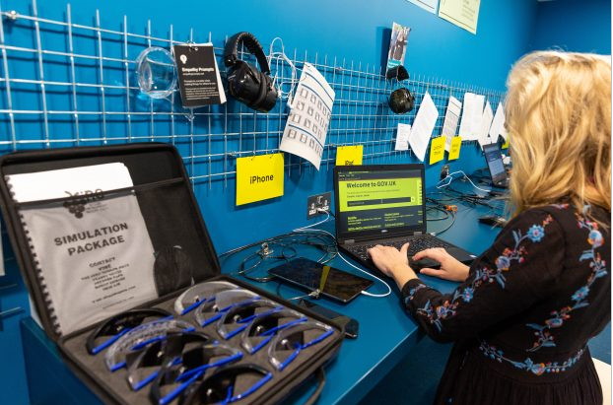
More info
https://www.jiscmail.ac.uk/cgi-bin/webadmin
Empathy Lab
www.policyconnect.org.uk/appgat/
GDS Guidance:
https://www.gov.uk/government/publications/sample-accessibility-statement/sample-accessibility-statement-for-a-fictional-public-sector-website
https://www.gov.uk/guidance/make-your-website-or-app-accessible-and-publish-an-accessibility-statement
https://www.gov.uk/guidance/accessibility-requirements-for-public-sector-websites-and-apps#how-the-accessibility-regulations-will-be-enforced

