Slide 1


How Jisc fell in love with the design sprint
26/09/2016
Andy McGregor, Deputy Chief Innovation Officer, Jisc

Slide 2
Our vision and aim
Vision
To make the UK the most digitally advanced education and research nation in the world
Aim
We aspire to be the world class powerhouse of digital support and transformation to the UK teaching and research communities

Slide 3
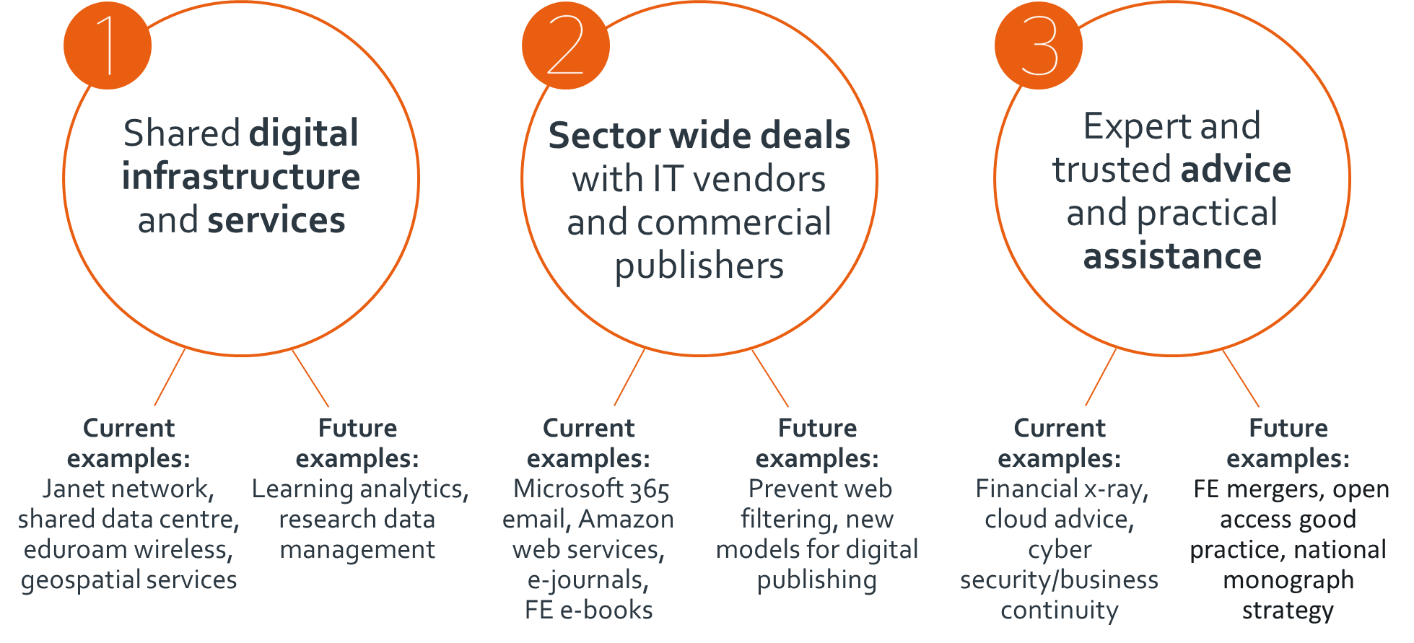
We do… three main things

Slide 4
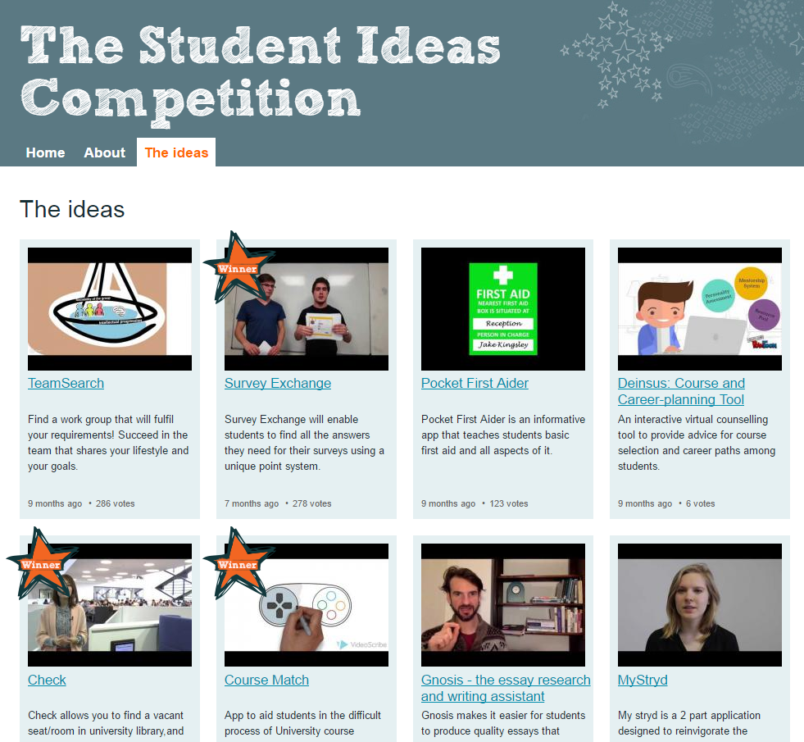
Summer of student innovation
https://www.jisc.ac.uk/rd/projects/summer-of-student-innovation-2016

Slide 5
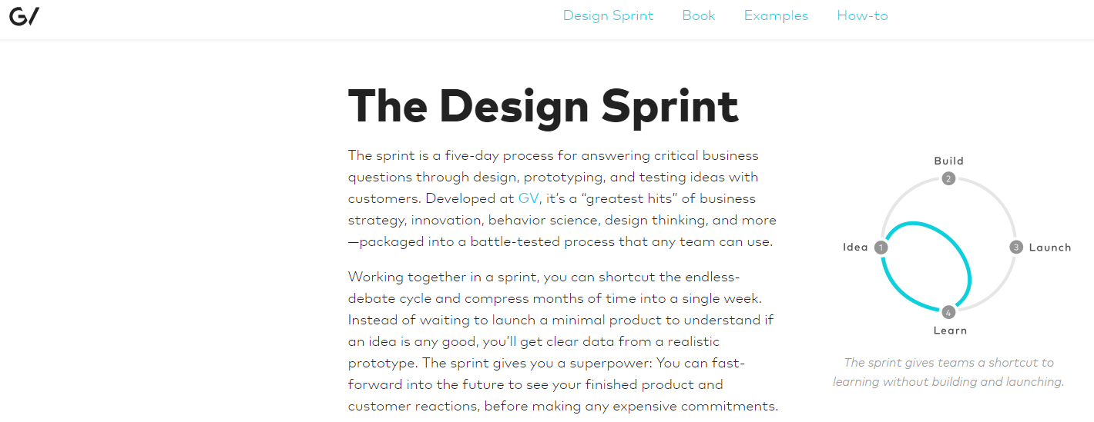
Inspiration
http://www.gv.com/sprint/

Slide 6
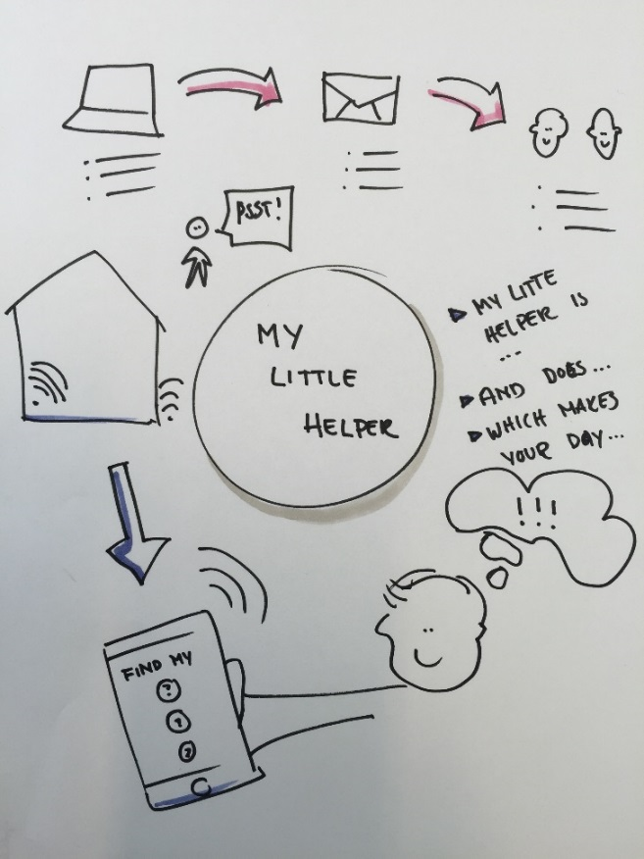
Our design sprint – day 1
Understanding the problem
Z
Challenges
Opportunities
Competitor analysis
User
Team……
Competitors
Our user….
Team……
Technology
Who?
Positives
Negatives
Who?
Positives
Negatives
Who?
Positives
Negatives
Background
ZA
SWOT Analysis
Helpful
Harmful
Business
A day in the life:
S
W
Who?
Positives
Negatives
Who?
Positives
Negatives
Strengths
Needs and Values:
Weaknesses
External
Internal
O
T
Their challenge is:
Opportunities
Threats

Slide 7
Our design sprint – day 2
Designing and developing the idea
User journey
Team……
Prototype storyboard
Team……
Before
Sign-up
Set-up
Use
Use again
1
2
3
4
5
Tech/biz
Team……
6
7
8
9
10
Description
What does it look like
a
11
12
13
14
15
Concept sheet
Team……
Value proposition
Description
What does it look like
Concept sheet
Team……
Concept sheet
Team……
What are the users needs, worries and wants?
How may the product respond to this?
Description
What does it look like
Concept sheet
Team……
Description
What does it look like

Slide 8
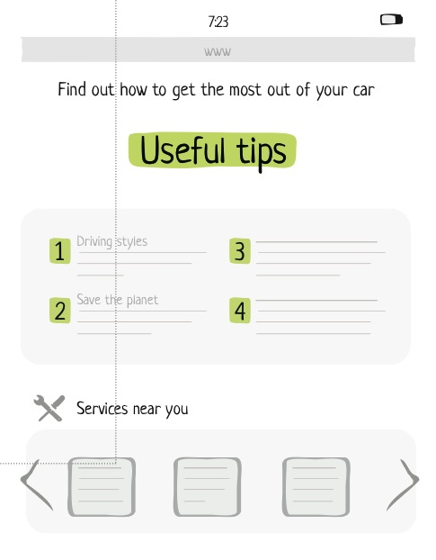
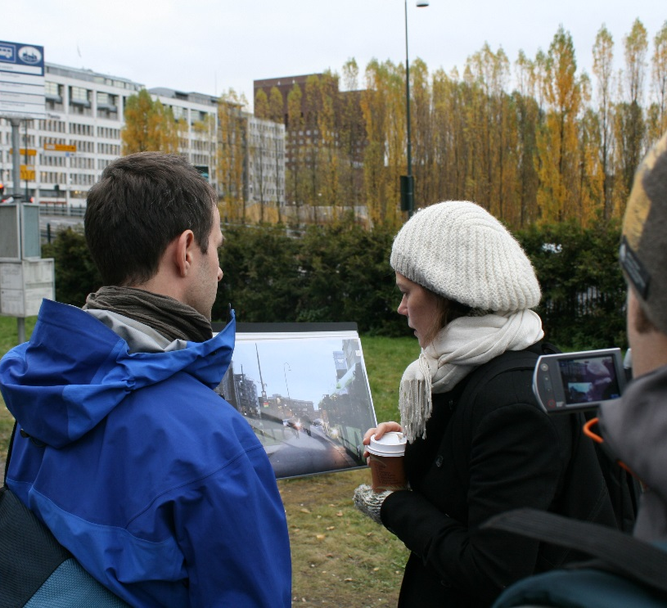
Our design sprint – day 3
Prototyping and testing

Slide 9
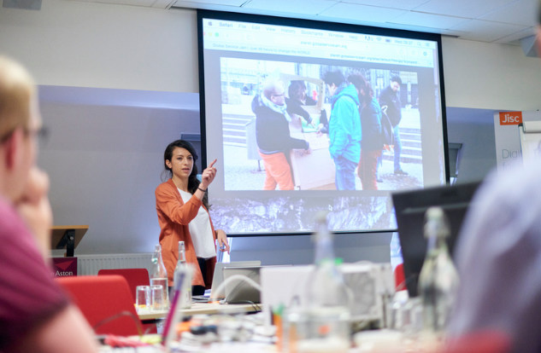
Our design sprint – day 4
Pitching

Slide 10
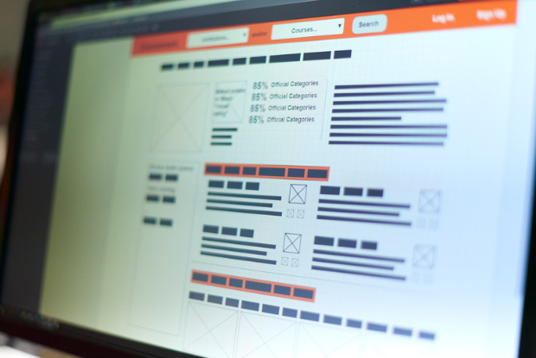
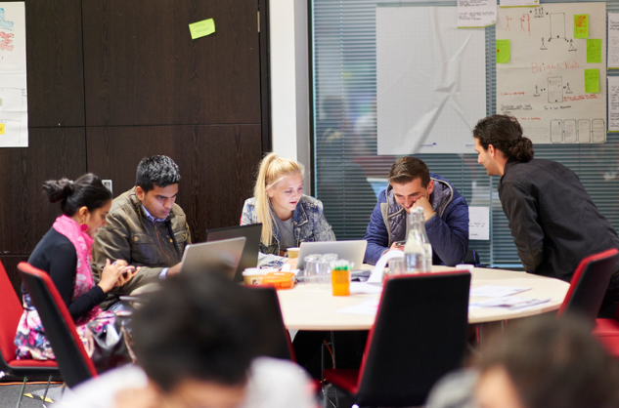
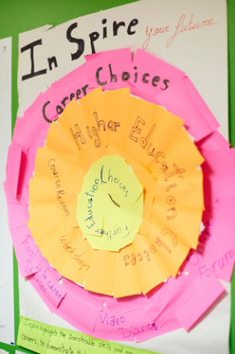
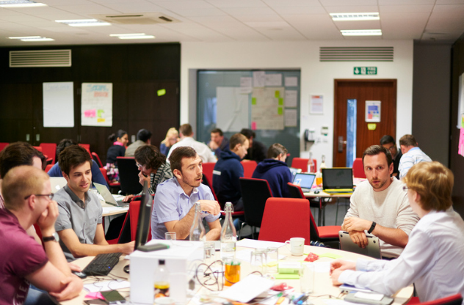
Action shots

Slide 11
What we’ve learned
Works for all types of ideas
Works at all lengths – but longer is better
Works for 1 idea at a time or 10 – pros and cons to both
Much better if ideas are formed before the sprint
Mentors/facilitators essential
Be flexible but don’t let people dismiss steps unchallenged
Ownership and enthusiasm are the two key factors

Slide 12
What could we do better
User testing
Reduce focus on pitching
Keep the energy going after the sprint

Slide 13
Thanks and get in touch
Andy McGregor
Deputy chief innovation officer
@andymcg
Andy.mcgregor@jisc.ac.uk

