Slide 1
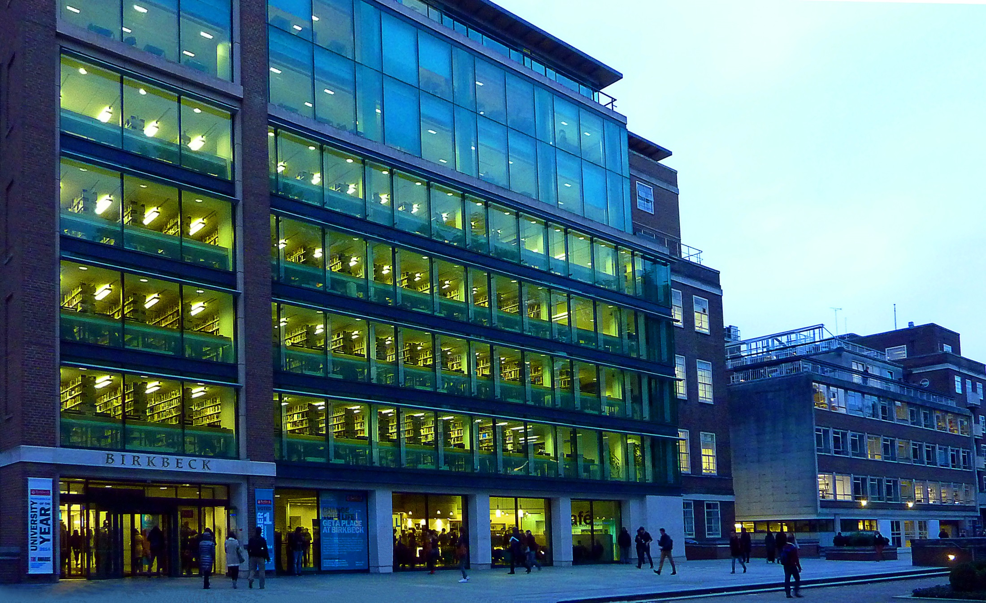
User experience (UX) research at Birkbeck Library

Slide 2
Motivations for doing the project
Growing body of evidence in LIS of the effectiveness of using these methods.
To involve our users to help in develop space and services.
To avoid survey fatigue by using different methods.
Notes:
Other university libraries are using these qualitative methods; York, Huddersfield, Cambridge, Royal Holloway…
Uxlibs conference started 2015 in the UK. Andy Priestner at Cambridge, Matt Borg at Proquest (formerly Sheffield Hallam) lead on this.
Examples from the USA in the Ethnographic Research in Illinois Academic Libraries (ERIAL) project.
Other examples in the suggested bibliography if you want to know more.
Existing methods are mostly quantitative; surveys, NSS, etc.
These methods will add to and complement those.

Slide 3
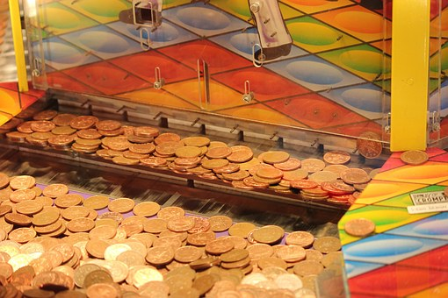
Alumni fund bid success
Notes:
We aim to get a more meaningful insight into the behaviour of our users in the library by using qualitative research methods so that we can develop our space and services more effectively. User centred approaches.

Slide 4
UX in a library context…
Originally ‘UX’ focused on design and usability testing of a website or software.
This has now broadened out and can be applied to space and services as well.
Notes:
This comes from Andy Priestner in CILIP update from May 2015.

Slide 5
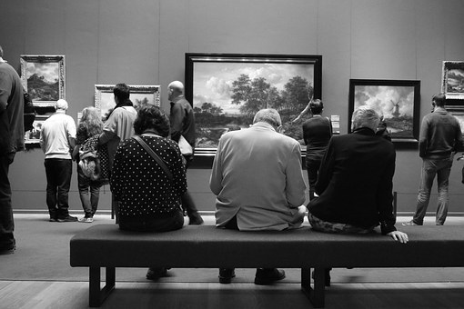
Ethnography defined…
Ethnography is simply a way of studying cultures through observation, participation and other qualitative techniques with a view to better understanding the subject’s point of view and experience of the world.
Notes:
Andy Priestner again…
Donna Lanclos all that crew.
We make assumptions, informed assumptions on what we think the students need/want, but do we really know?

Slide 6
Activities
Observation
Cognitive mapping
Touchstone tours
Focus group
Notes:
We employed students to facilitate these activities, with the exception of the focus group, which were facilitated by library staff.
For us it was important to get student involvement from the start.

Slide 7
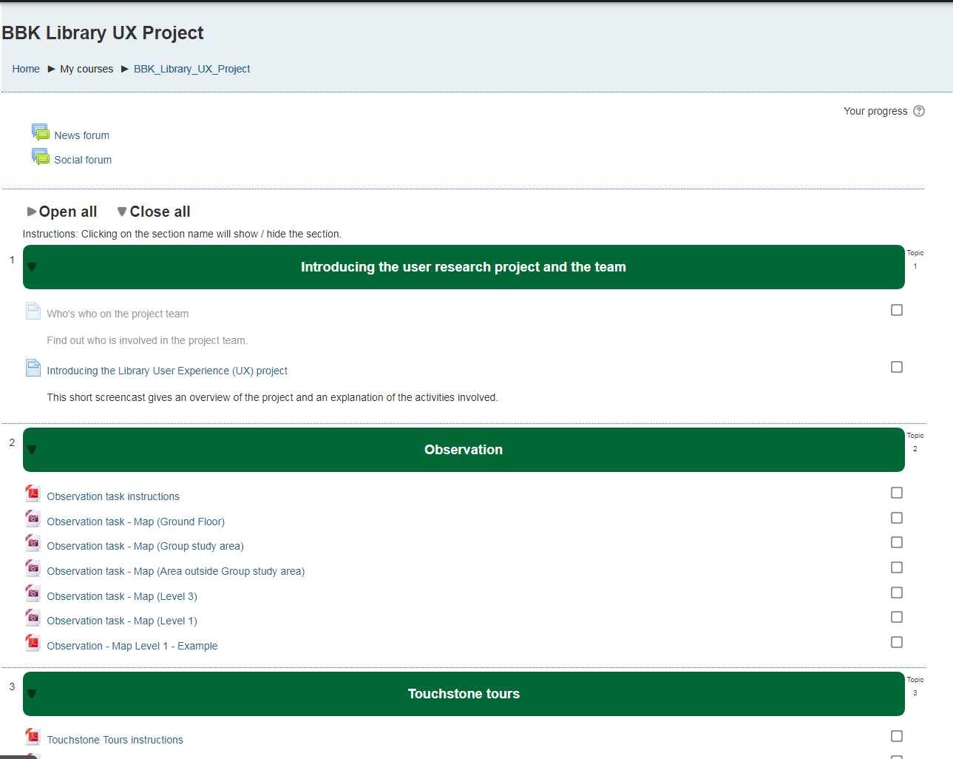
Training
Notes:
We used Moodle for the materials to support the face to face training we did with the students facilitating the activities.

Slide 8
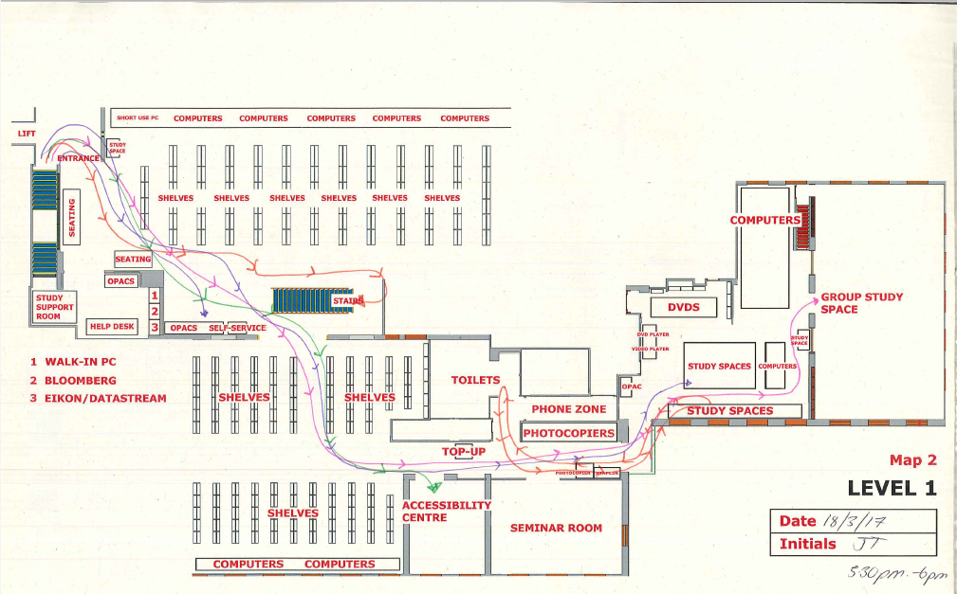
Observation
Notes:
Look to see how users move through and use the library space. Record their movements.
Where do they go?
How to they get there?
What do they use?
What do they ignore?

Slide 9
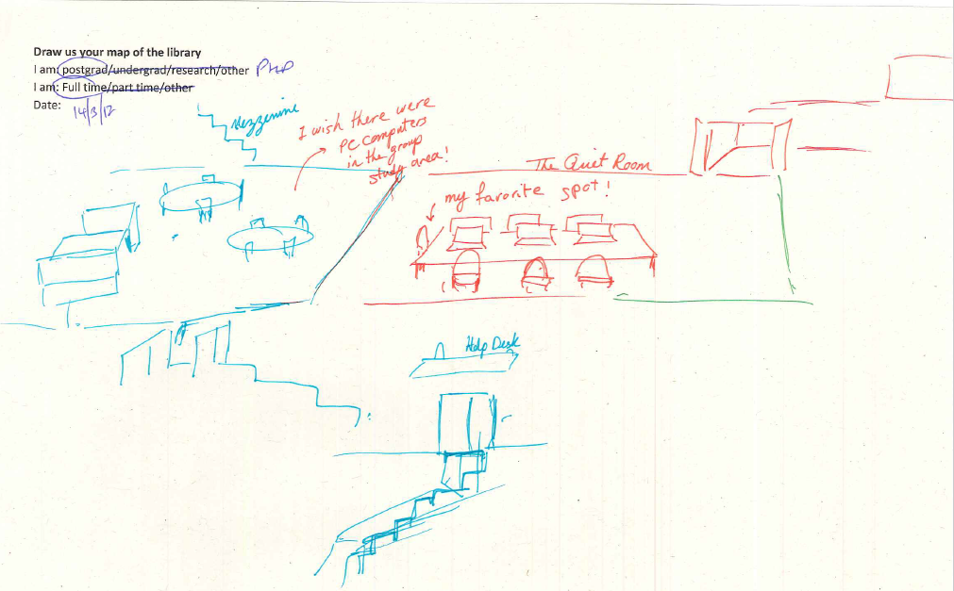
Cognitive mapping
Notes:
Ask people to draw their map of the library in 6 minutes, changing colour of pen every 2 minutes.

Slide 10
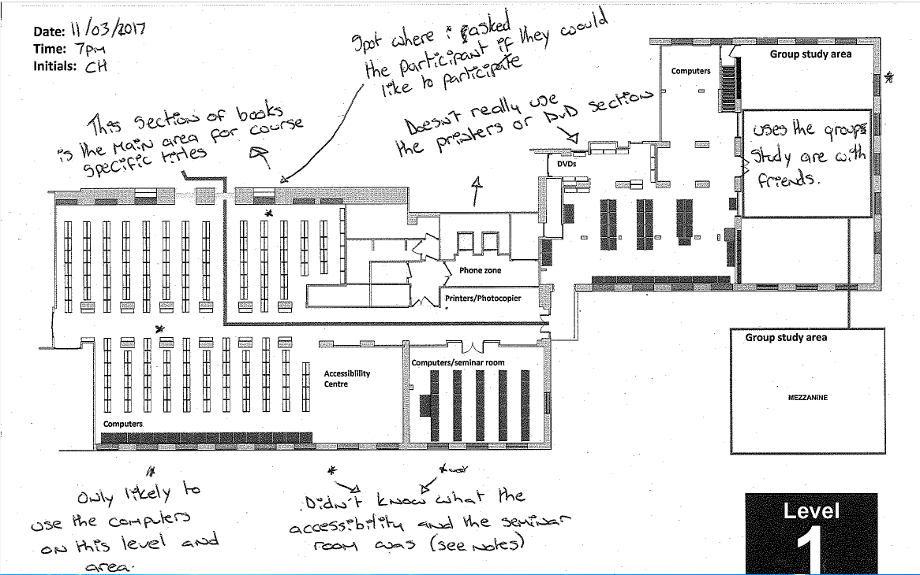
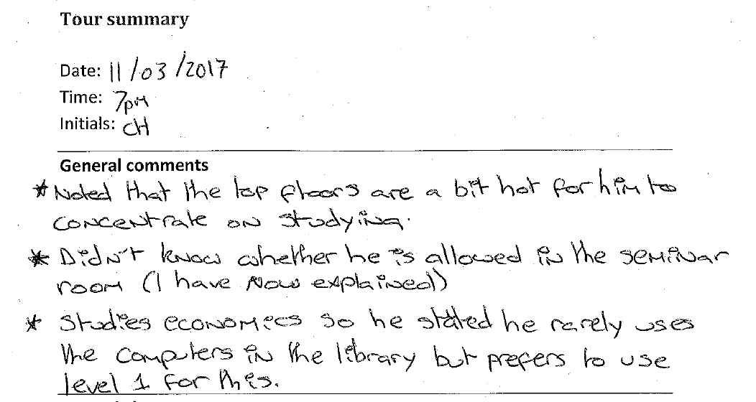
Touchstone tours
Notes:
Ask the user to take you on a tour of the library, rather than you taking them. Record what they say.

Slide 11
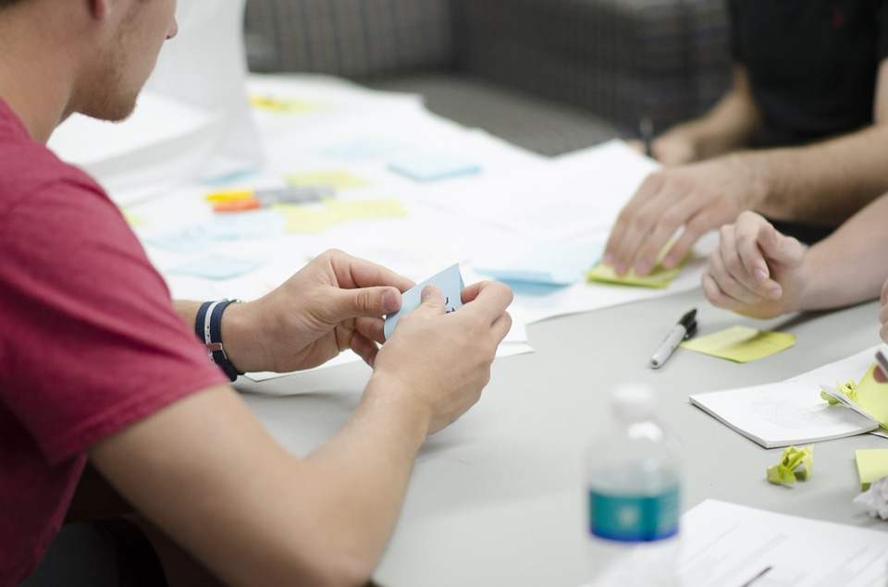
Focus group
Notes:
4 focus groups, 2 hours per focus group
Tuesday
Thursday
Sunday

Slide 12
Completed Activities
Activity | Week 1 Sat 04/03 –Thurs 09/03 | Week 2 Sat 11/03 – Fri 17/03 | Week 3 Sat 18/03 – Thurs 23/03 | Total
Cognitive maps | 20 | 16 | 15 | 51
Touchstone tours | 14 | 15 | 13 | 42
Observations | 9 hours | 5 hours | 4 hours | 18 hours
Focus groups |  |  | 4 | Circa 8 hours
Notes:
By the end of March Team Birkbeck-ers and Library staff had carried out these activities with students.

Slide 13
Data Analysis
Notes:
Time consuming!
Used a grounded theory approach
Colleague built a database for us
Existing understanding staff activity
Allocating analysis tasks – we each took an activity

Slide 14
Pre-understanding activity
Notes:
Cross section of library staff
Undertook the same activities from the point of view of a student

Slide 15
Coding the data/allocating themes and sub themes
Notes:
General approach to this/individual approach? Wanted to give the freedom to individuals to code according to their impressions, but now trying to get more generic groups for searchability.
Dependent on activity? Some more quantitative than qualitative

Slide 16
Emerging themes
Environment | Student behaviour | Help and guidance | Resources | Quantitative
Temperature | Noise | Signage | Electronic
Light | Food and drink | Staff | Print
Study space (?) | Use of space | Issue Desk | Computers
 | Library rules (?) | Help Desk | MFDs (Printers, photocopiers, scanners)
 |  | Self-help eg. instruction | Wifi
Notes:
The four broad theme and a bit about sub themes?
Would be good to talk about the ‘how’ as well (different slide?) – ie some of the codes that emerged which weren’t themes, particularly in Noemi’s work on the focus groups.

Slide 17
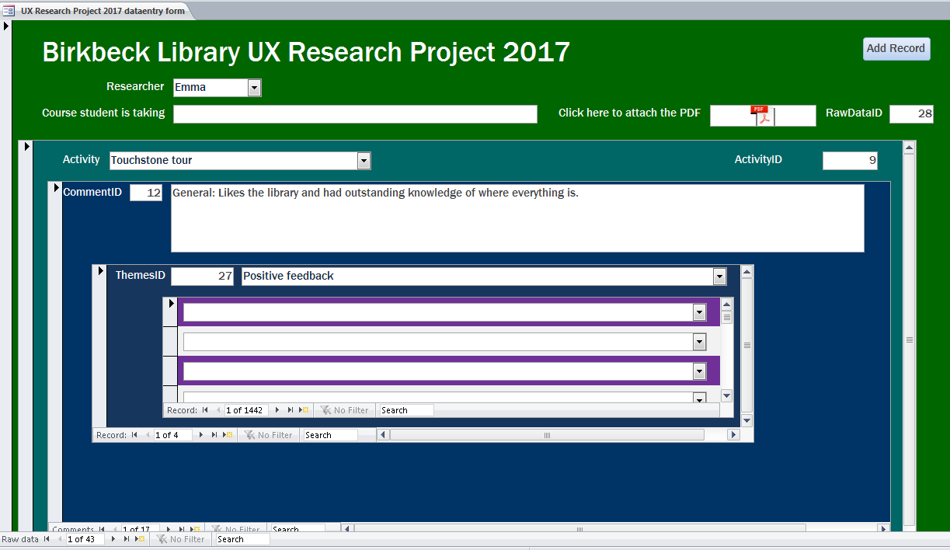
The database
Notes:
Screenshot one shows the data entry screen
Screenshot two shows the report running options

Slide 18
Challenges
Notes:
Anything in particular?
Learning about different qualitative approaches
Thinking about and deciding on themes That this was a bit structured but a bit organic at the same time
Time challenges of doing this on top of our day jobs
Different approaches taken by different team Birkbeck students (eg with cognitive maps) making comparison harder
Data being so variable, and considering which kinds of data are useful.

Slide 19
Data day
Notes:
Broad ranging discussion, plenty of time
Sharpened our view and lead into the writing

Slide 20
Research outcomes
Recommendations
Temperature
The Lift
Availability of study spaces during ‘rush hour’ 4-6pm
Demarcation of space, clarity of behaviour expectations
The Collection
Availability of staff
Information
Facilities

Slide 21
Images
Images came from either pexels.com, pixaby.com and are CC0.
Or they are ones we took ☺

