Slide 1
Research & Evaluation: Making use of analytics and testing techniques
Dimitra Bazani
User Experience Architect
City, University of London

Slide 2
At the end of this session
What
Why
When
How
Tools

Slide 3
What is User research?
The “Who & Why.”
Understanding end user needs and expectations for the same product or service.

Slide 4
Diversified research methodologies
UserTesting 2017 Industry Survey

Slide 5
What is Usability Testing?
“Usability testing is a technique used in user-centered interaction design to evaluate a product by testing it on users. This can be seen as an irreplaceable usability practice, since it gives direct input on how real users use the system”
Wikipedia

Slide 6
Why?
“Actual humans will expose problems you’ve failed to identify during your design and development process. Even the best teams can’t predict every possible pitfall.”
Michael McWatters
UX Architect at TED in NYC

Slide 7
Is Usabitility Research important?

Slide 9
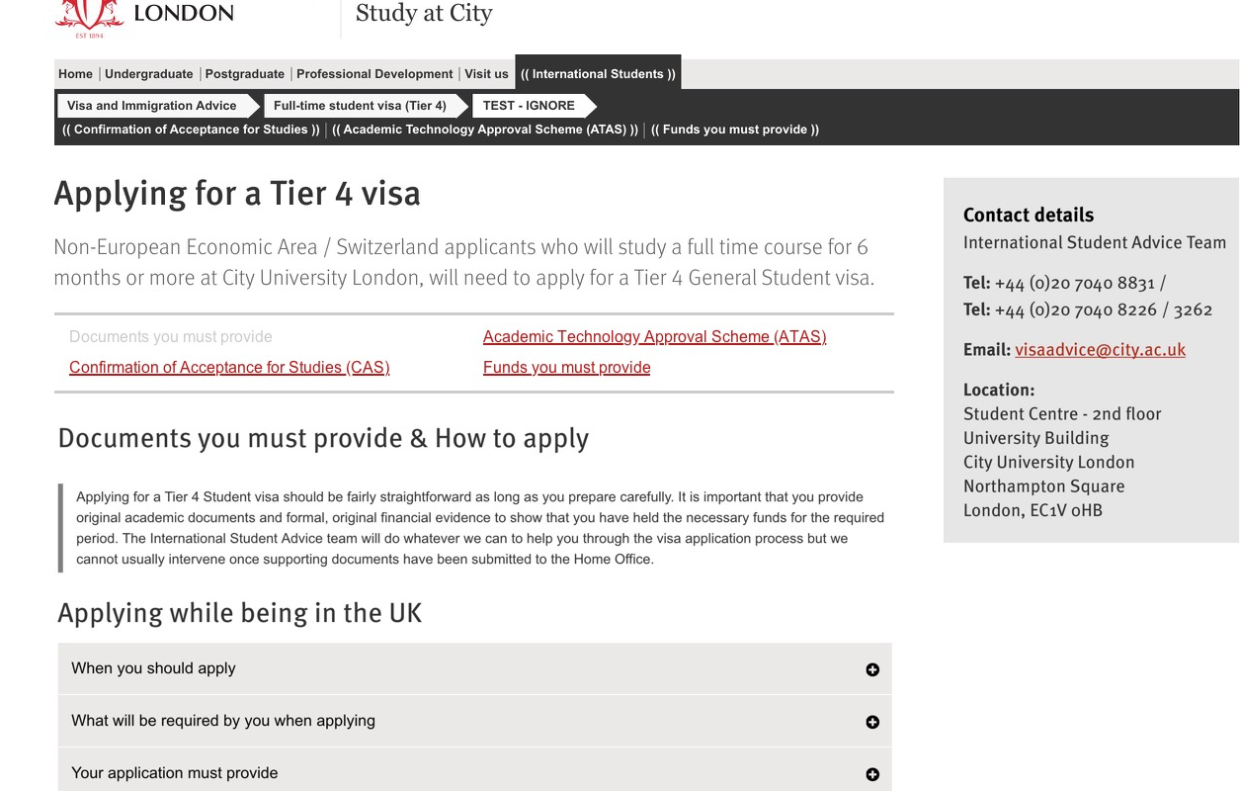

Slide 10
Is Usabitility Research important?
Video

Slide 11
Is Usabitility Research important?

Slide 12
Let’s play “reasons Not to do Usability Research”.
Try to find 3 reasons why we should not do a usability research.
(no prizes I’m afraid ☹)

Slide 13
Another Example
Old design
New design

Slide 14
Video

Slide 15
When?
Discovery
Design
Development
Launch

Slide 16
When?
It’s Never the Wrong Time to Test!

Slide 17
How?
Goal. Before starting the test, set the ground rules. ...
Recruiting ...

Slide 18
How?
Preparing for the study.
Scenarios,
Tasks,
Post-test questionnaire …

Slide 19
How?
Conducting. ...
Analyzing. ...
Reporting.

Slide 20
Tools
Online user testing
https://www.usertesting.com/
https://www.clicktale.com/
https://userbrain.net/
http://www.openhallway.com/
https://usabilla.com/

Slide 21
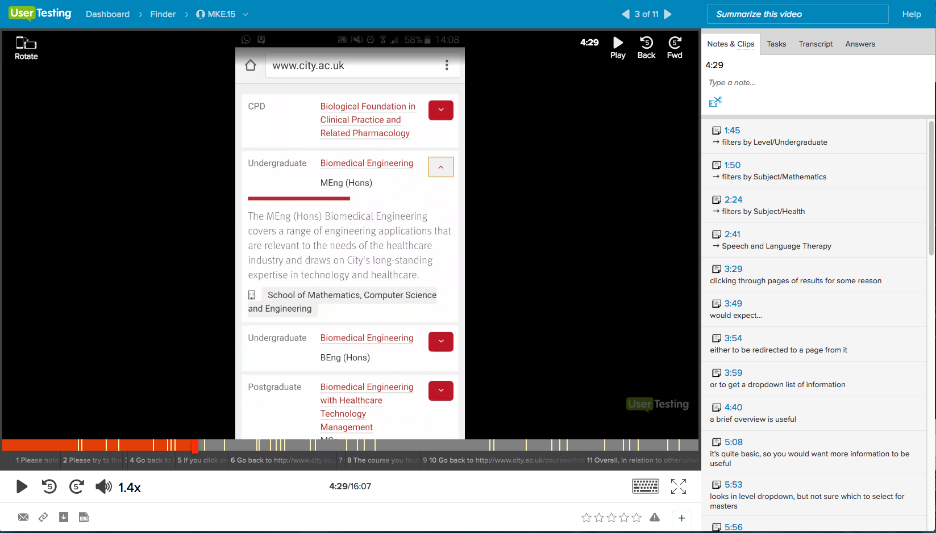

Slide 22
Tools
User clicks and heat map
https://www.crazyegg.com/

Slide 24
Tools
First click test and Tree jack test
https://www.optimalworkshop.com/
http://www.userzoom.com

Slide 25
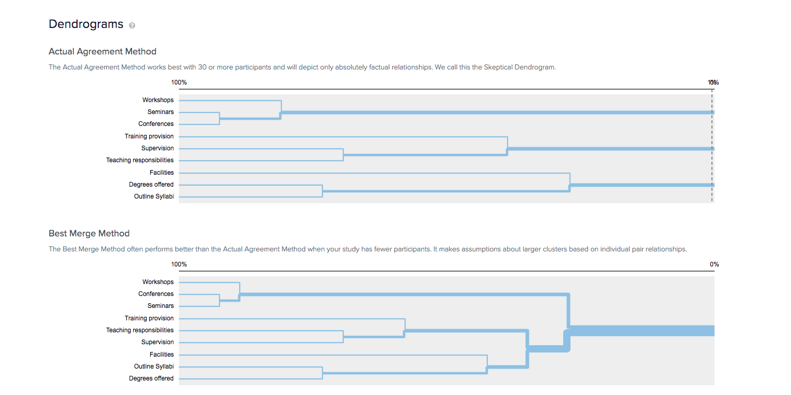

Slide 28
Questions?
Dimitra Bazani
User Experience Architect
City, University of London
Dimitra.bazani@city.ac.uk

